Slide 1
Project on
E-retail factors for customer activation and retention
Presented by
Ganta Ganesh

Slide 2
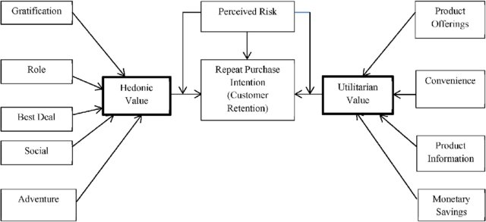
Problem Statement
E-retail factors for customer activation and retention: A case study from Indian e-commerce customers
Customer satisfaction has emerged as one of the most important factors that guarantee the success of online store, it has been posited as a key stimulant of purchase, repurchase intentions and customer loyalty. A comprehensive review of the literature, theories and models have been carried out to propose the models for customer activation and customer retention. Five major factors that contributed to the success of an e-commerce store have been identified as: service quality, system quality, information quality, trust and net benefit. The research furthermore investigated the factors that influence the online customers repeat purchase intention. The combination of both utilitarian value and hedonistic values are needed to affect the repeat purchase intention (loyalty) positively. The data is collected from the Indian online shoppers. Results indicate the e-retail success factors, which are very much critical for customer satisfaction.

Slide 3
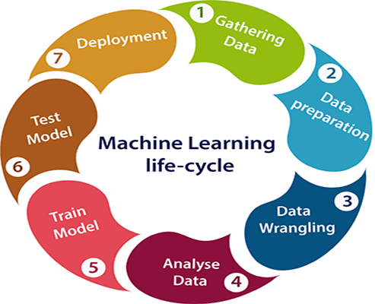
Steps Involved in Building Machine Learning Project
Gathering Data
Data Preparation
Data Wrangling
Analyze Data
Train the model
Test the model
Deployment

Slide 4
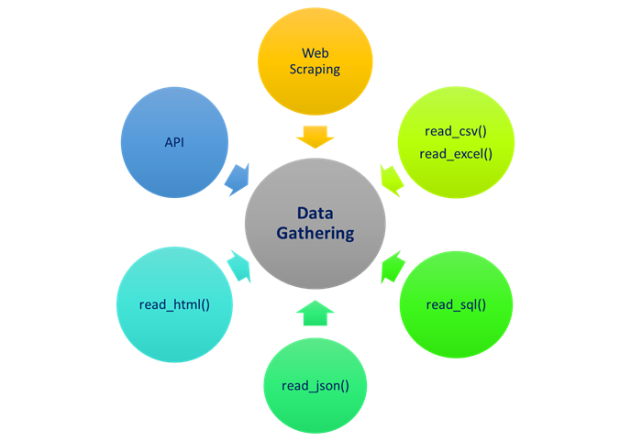
Gathering Data
In this step, we need to identify the different data sources, as data can be collected from various sources such as files, database, internet, or mobile devices.
In our project, we have collected the data from files through available resources and stored in our local storage.

Slide 5
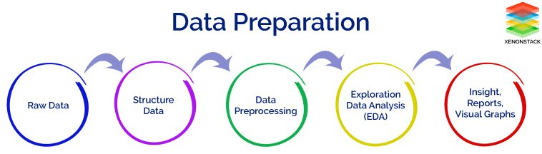
Data Preparation
After collecting the data, we need to prepare it for further steps. Data preparation is a step where we put our data into a suitable place and prepare it to use in our machine learning training.
This step can be further divided into two processes:
Data exploration: It is used to understand the nature of data that we have to work with. We need to understand the characteristics, format, and quality of data. A better understanding of data leads to an effective outcome. In this, we find Correlations, general trends, and outliers.
Data pre-processing: Now the next step is preprocessing of data for its analysis.

Slide 6
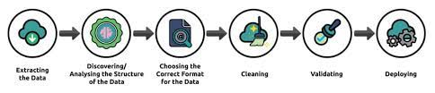
Data wrangling
Data wrangling is the process of cleaning and converting raw data into a useable format. It is the process of cleaning the data, selecting the variable to use, and transforming the data in a proper format to make it more suitable for analysis in the next step. It is one of the most important steps of the complete process. Cleaning of data is required to address the quality issues.
It is not necessary that data we have collected is always of our use as some of the data may not be useful. In real-world applications, collected data may have various issues, including:
Missing Values
Duplicate data
Invalid data
Noise
So, we use various filtering techniques to clean the data.
It is mandatory to detect and remove the above issues because it can negatively affect the quality of the outcome.

Slide 7
Analyze Data
Now the cleaned and prepared data is passed on to the analysis step. This step involves:
Selection of analytical techniques
Building models
Review the result
The aim of this step is to build a machine learning model to analyze the data using various analytical techniques and review the outcome. It starts with the determination of the type of the problems, where we select the machine learning techniques such as Classification, Regression, Cluster analysis, Association, etc. then build the model using prepared data, and evaluate the model.
In our project, we used principal component analysis to reduce dimensions in our dataset.

Slide 8
Principal Component Analysis
Principal Component Analysis is an unsupervised learning algorithm that is used for the dimensionality reduction in machine learning. It is a statistical process that converts the observations of correlated features into a set of linearly uncorrelated features with the help of orthogonal transformation. These new transformed features are called the Principal Components. It is one of the popular tools that is used for exploratory data analysis and predictive modeling. It is a technique to draw strong patterns from the given dataset by reducing the variances.
PCA generally tries to find the lower-dimensional surface to project the high-dimensional data.
PCA works by considering the variance of each attribute because the high attribute shows the good split between the classes, and hence it reduces the dimensionality.
It is a feature extraction technique, so it contains the important variables and drops the least important variable.

Slide 9
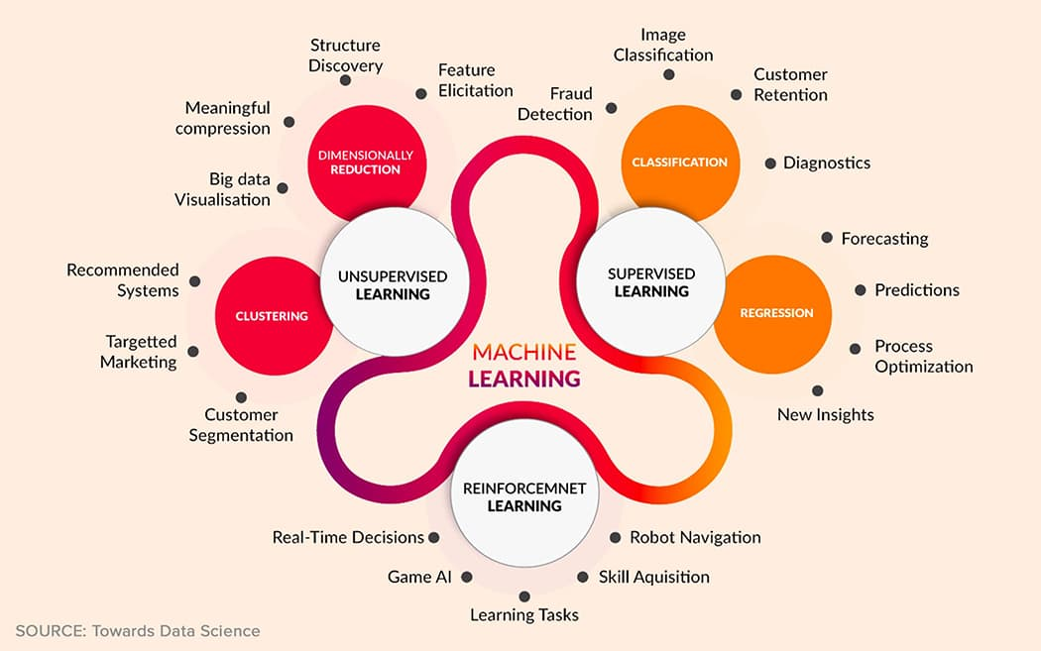
Model Building
We build our model using Classification Models.
Various classifications we used in model building are:
Logistic Regression
Gaussian Naive Bayes Classifier
Decision Tree Classifier
Random Forest Classifier

Slide 10
Logistic Regression
Logistic regression measures the relationship between the categorical dependent variable and one or more independent variables by estimating probabilities using a logistic function, which is the cumulative distribution function of logistic distribution.
Gaussian Naive Bayes Classifier
The Gaussian Processes Classifier is a classification machine learning algorithm. Gaussian Processes are a generalization of the Gaussian probability distribution and can be used as the basis for sophisticated non-parametric machine learning algorithms for classification and regression.
Decision Tree Classifier
Decision Tree is a Supervised learning technique that can be used for both classification and Regression problems, but mostly it is preferred for solving Classification problems. It is a tree-structured classifier, where internal nodes represent the features of a dataset, branches represent the decision rules and each leaf node represents the outcome.
Random Forest Classifier
Random forests is a supervised learning algorithm. It can be used both for classification and regression. It is also the most flexible and easy to use algorithm. A forest is comprised of trees. It is said that the more trees it has, the more robust a forest is. Random forests creates decision trees on randomly selected data samples, gets prediction from each tree and selects the best solution by means of voting. It also provides a pretty good indicator of the feature importance.

Slide 11
Train Model
Now the next step is to train the model, in this step we train our model to improve its performance for better outcome of the problem.
We use datasets to train the model using various machine learning algorithms. Training a model is required so that it can understand the various patterns, rules, and, features.
Test Model
Once our machine learning model has been trained on a given dataset, then we test the model. In this step, we check for the accuracy of our model by providing a test dataset to it.
Testing the model determines the percentage accuracy of the model as per the requirement of project or problem.

Slide 12
Deployment
The last step of machine learning life cycle is deployment, where we deploy the model in the real-world system.
If the above-prepared model is producing an accurate result as per our requirement with acceptable speed, then we deploy the model in the real system. But before deploying the project, we will check whether it is improving its performance using available data or not. The deployment phase is similar to making the final report for a project.

Slide 13
THANK YOU

